Slide 1
Mobile Apps and Evidence-Based Medicine
Bob Marshall, MD MPH MISM FAAFP
DoD/MAMC Clinical Informatics Fellowship

Slide 2
Learning Objectives
Present a number of mobile medical apps
Break down the apps by user groups
Discuss the relative EBM merits of the various apps

Slide 3
Apps for Patients

Slide 4
Medisafe Pill Reminder, Medication and Prescription Organizer
Medisafe has the advantage of an extremely large number of users
It appears to work and work well
Recording one's medications in the app is as easy as possible
Customizable reminders can be set to prompt users to take their medicines at specified times, and the app then records those medicines as having been taken
The app even sends a reminder when it is time to renew each prescription

Slide 5
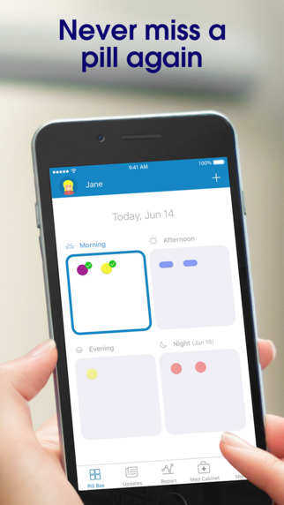
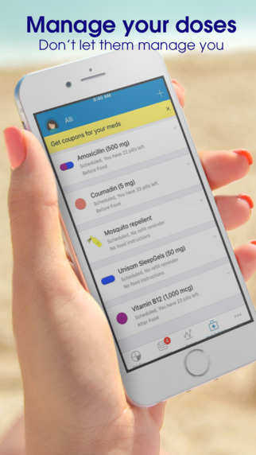
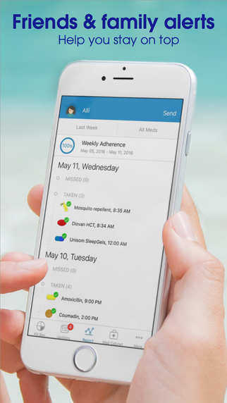

Slide 6
Lab Tests Online-M
Created by the American Association for Clinical Chemistry, this app does a wonderful job of explaining why hundreds of lab tests are administered, what they are used to measure, how they are performed, what preparations are required, and much more
Doesn't address what the normal or abnormal lab ranges are
Provides a rich and accurate understanding of the tests' importance, clinical context, and what factors can influence the results
the mobile version of Lab Tests Online®,

Slide 7
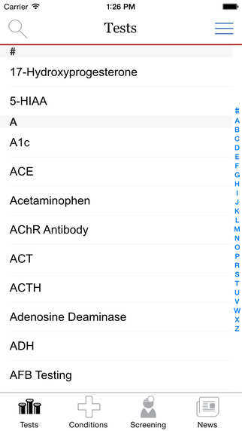
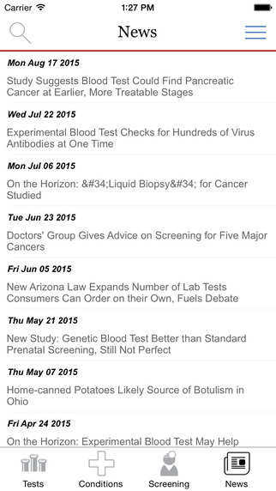
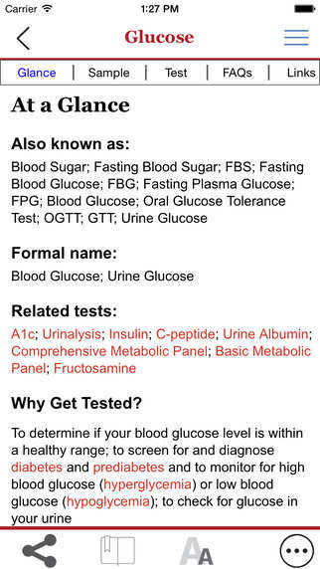

Slide 8
KnowBullying by SAMHSA
Parents concerned that their children may be experiencing bullying would benefit from this app by the Substance Abuse and Mental Health Services Administration (SAMHSA)
Provides information and advice on what to do, and what not to do, to help children cope with and resolve bullying situations, including cyberbullying
Research shows that spending at least 15 minutes a day talking with your kids can build the foundation for a strong relationship, develop their resilience to peer pressure, and help prevent bullying
Get tips about bullying for specific age groups: 3-6, 7-13, and teens

Slide 9
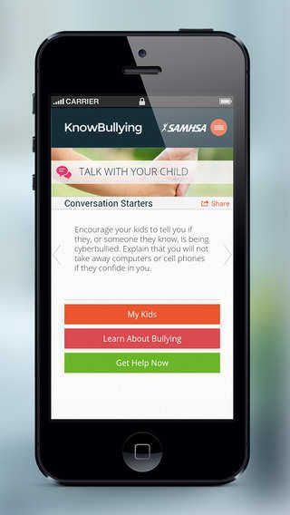
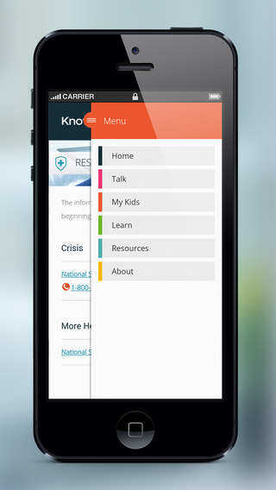
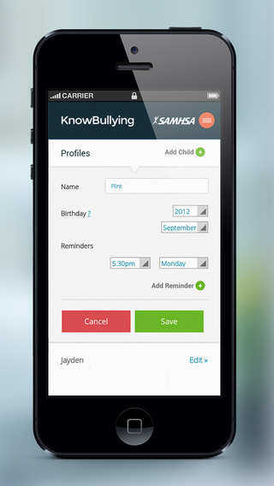

Slide 10
Apps for Providers

Slide 11
OHN SBIRT
Makes it easy for healthcare practitioners to use clinically validated questionnaires to screen patients for alcohol or substance abuse, depression, or anxiety, and provides guidelines for intervention and referral when appropriate
Created by the University of California-San Francisco SBIRT group with funding from the Substance Abuse and Mental Health Services Administration (SAMHSA)
Screening, brief intervention, and referral to treatment (SBIRT) is a comprehensive, integrated, public health approach to the delivery of early intervention and treatment services

Slide 12
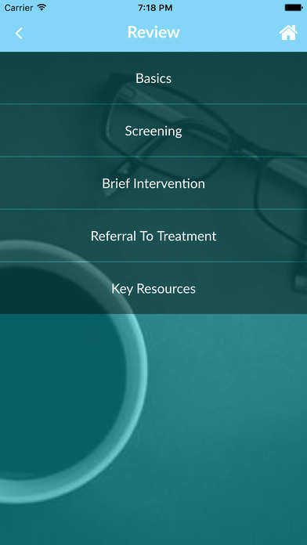
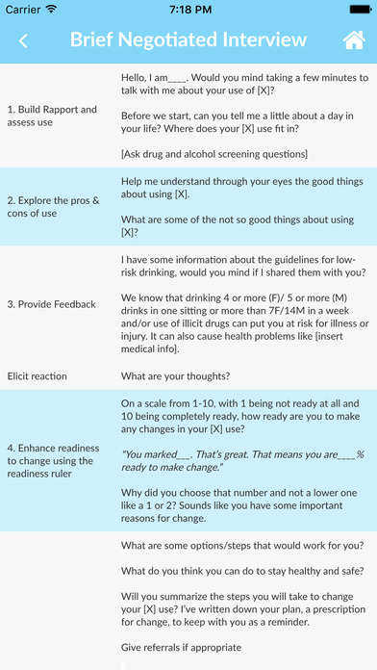
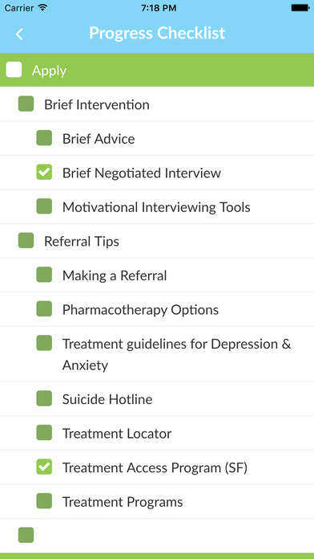

Slide 13
Aspirin Guide
It is important to assess the relative risks and benefits of prophylactic aspirin therapy, balancing patients' risk factors for heart disease against their risk of GI bleed.
Created by researchers from the Brigham and Women's Hospital, this mobile app prompts users to enter information about a patient's risk factors and then calculates a 10-year ACC/AHA ASCVD score as well as a bleeding risk score, enabling clinicians to make an informed recommendation

Slide 14
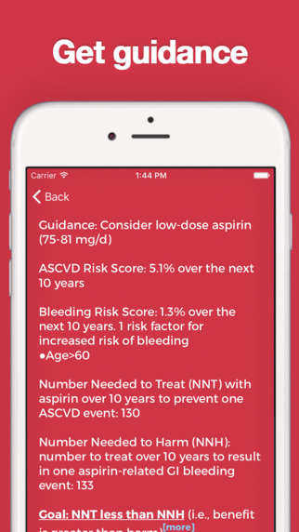
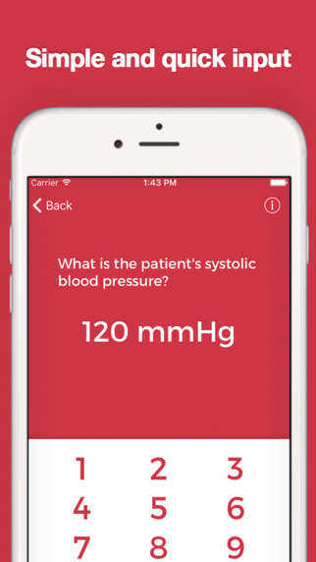
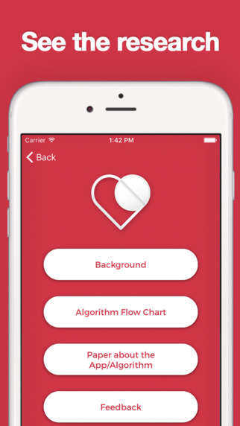

Slide 15
CardioVisual
CardioVisual helps healthcare professionals explain cardiovascular diseases and treatments, and to help patients understand them
It uses well-crafted, narrated videos to quickly and accessibly demonstrate each form of heart disease, as well as its associated treatments and devices
The app also offers illustrations that clinicians can draw on or mark up while talking to patients, to elucidate specific points or highlight particular anatomical areas
Patients can download the app too

Slide 16
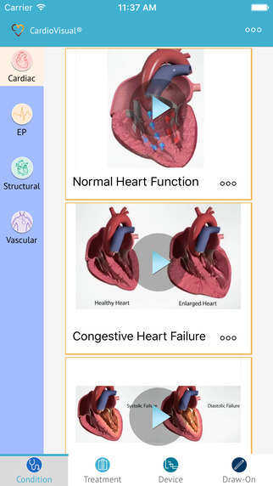
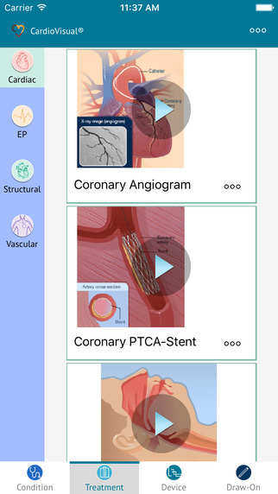
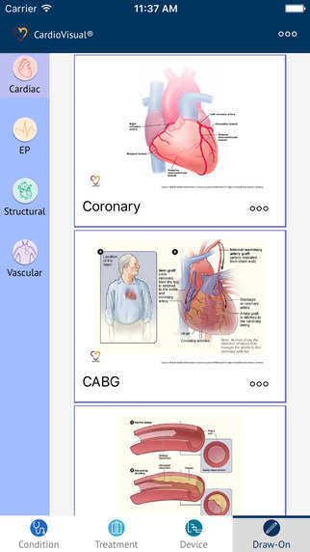

Slide 17
BiliMatic
Well-designed app that allows users to quickly ascertain whether a newborn's serum bilirubin levels are within low-risk, medium-risk, or high-risk range
One simply enters the infant's age, time/date when blood was drawn, and bilirubin number, and the app plots that value onto a chart that uses the American Academy of Pediatrics' phototherapy reference nomogram from the 2004 Guidelines for Hyperbilirubinemia
The nomogram is browsable, allowing you to read reference values for low/medium/high risk newborns with a touch of your finger
It's easy to change from mg/dL to µmol/L, along with other parameters

Slide 18
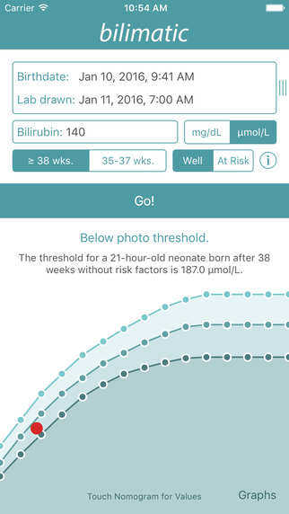
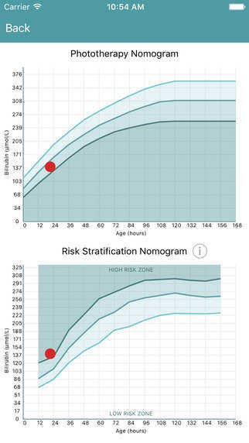
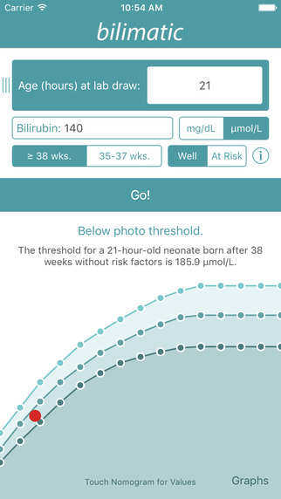

Slide 19
Human Dx
Human Dx is the mobile interface for the Human Diagnosis Project, an ambitious, open-source international effort to build global acumen concerning the vast range of human diagnoses
With Human Dx, in minutes, physicians and medical students can collaborate on clinical cases to help patients everywhere, while enhancing their own clinical reasoning
Each case helps build the Human Diagnosis Project, a worldwide effort to map any health problem to its possible diagnoses
For practitioners who are dedicated to advancing the art and science of diagnosis, both for themselves and for medicine as a whole, participation in the Human Diagnosis Project is highly recommended

Slide 20
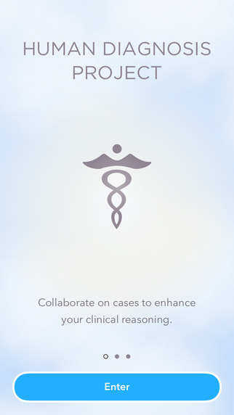
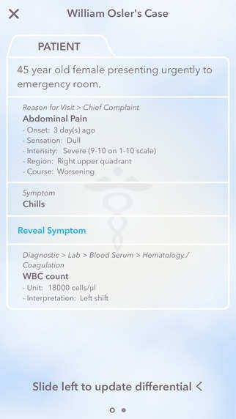
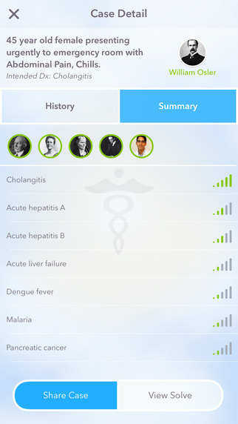

Slide 21
Narcolepsy Screener
The Narcolepsy Screener App is designed to provide doctors with two validated screening tools that can help screen patients for excessive daytime sleepiness and narcolepsy with cataplexy
The screening tools are known as the Swiss Narcolepsy Scale and the Epworth Sleepiness Scale
The tools may be used together or separately
The app provides an interpretation of the screening results along with suggested follow-up

Slide 22
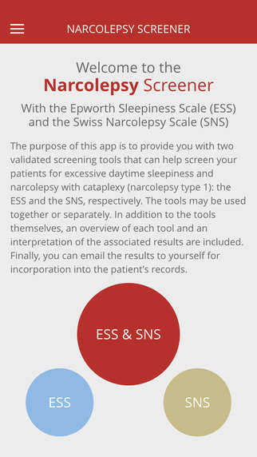
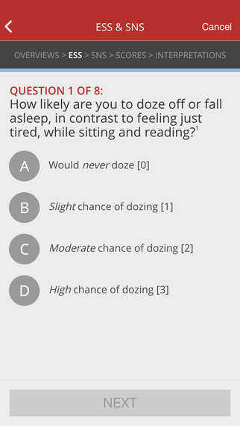
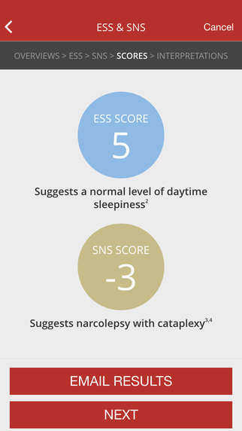

Slide 23
Endocrine Clinical Practice Guidelines
The Endocrine Society Clinical Practice Guidelines app, covering the areas of:
post-bariatric surgery management, adult hypoglycemic disorders, pharmacological management of obesity, diabetes and pregnancy, prevention of cardiovascular disease and type 2 diabetes in patients at metabolic risk, and management of hyperglycemia in inpatients
Each subject area includes a clinical practice guideline synopsis and a number of calculators and/or algorithms, as well as links to relevant articles

Slide 24
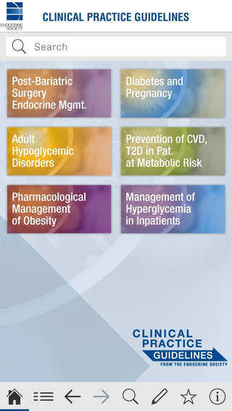
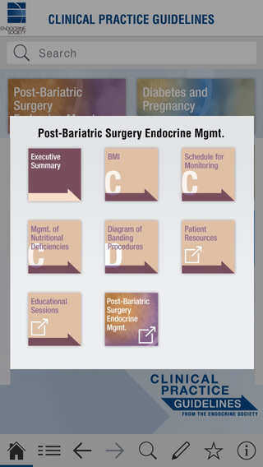
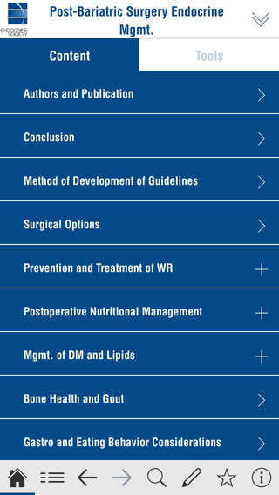

Slide 25
Resident Intern Endocrinology Companion
Includes the basics of presentation, differential diagnosis, workup, and treatment for a variety of diseases commonly treated by endocrinologists
Topics include Thyroid, Pituitary, Adrenal, Pancreas, Osteoporosis, Obesity, and Vitamin D
There is an in-depth guide regarding the treatment of DKA and insulin pump quick reference
The application also includes useful calculators for insulin dosing, sodium correction for glucose, calcium correction for albumin, and more

Slide 26
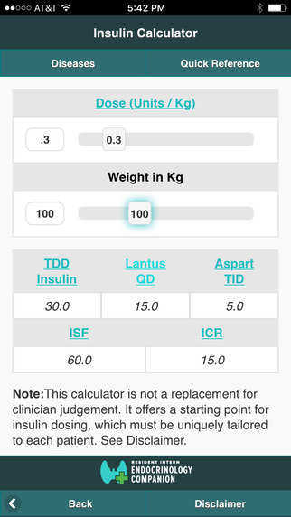
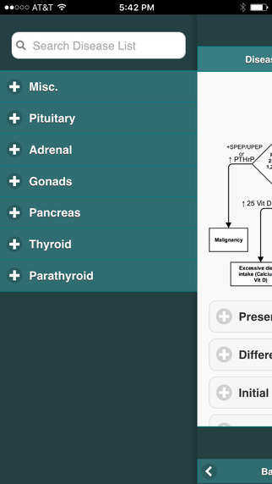
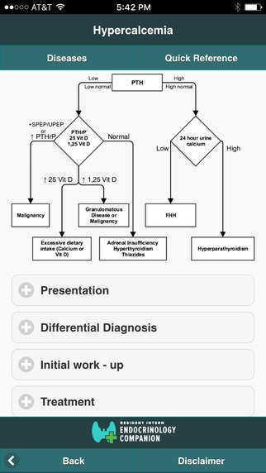

Slide 27
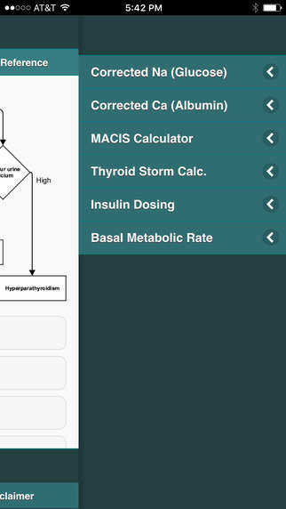
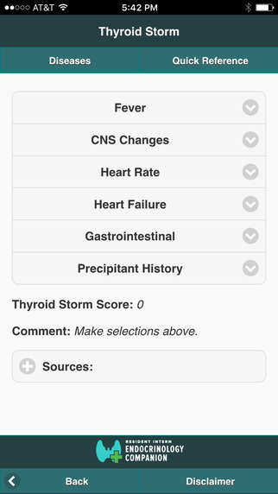

Slide 28
Suicide Safe by SAMHSA
Suicide Safe is a suicide prevention learning tool for primary care and behavioral health providers and is based on the nationally recognized Suicide Assessment Five-step Evaluation and Triage (SAFE-T) practice guidelines
From the Substance Abuse and Mental Health Services Administration (SAMHSA)
Offers tips and techniques, case studies, and conversation starters as well as resources: treatment locator, crisis lines, professional education sites, information on ICD-10 coding, and other useful assets to help HCPs care for individuals who are experiencing suicidal ideation

Slide 29
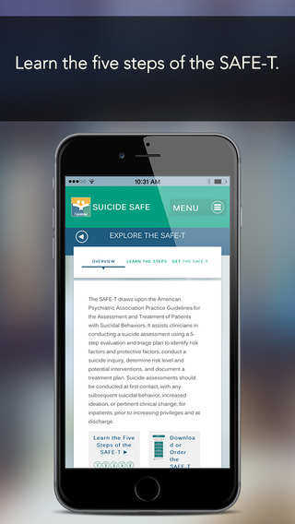
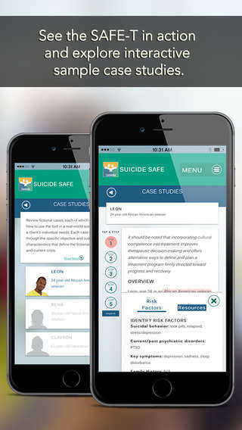
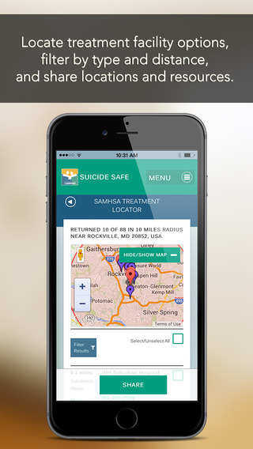

Slide 30
STD Tx Guide
From the CDC
These guidelines for the treatment of persons who have, or are at risk for, sexually transmitted diseases (STDs) were updated by CDC after consultation with a group of professionals knowledgeable in the field of STDs (SOR C)
Contains links to the CDC's complete STD guidelines online, which are much more comprehensive than the app itself (and are mobile friendly)
Covers a wide area in the world of STD’s

Slide 31
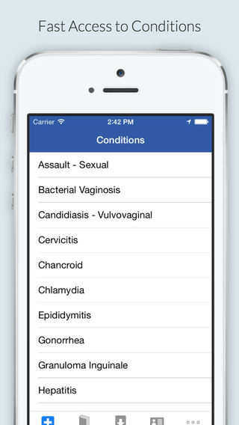
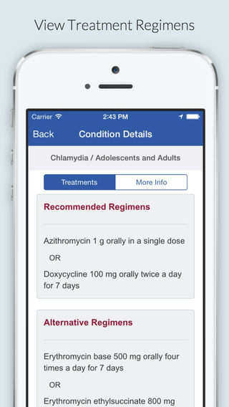
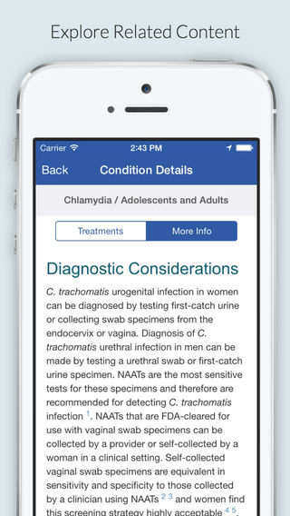

Slide 32
ACC Guideline Clinical App
The American College of Cardiology created this app to give healthcare professionals a portable way of accessing the society's guidelines on blood cholesterol, cardiovascular risk, heart failure, atrial fibrillation, valvular heart disease, lifestyle, obesity, non-ST-elevation ACS, and perioperative management
Replete with algorithms, interactive tools, calculators, and much more
Users can also add notes and bookmarks and perform quick searches
Virtually a concise textbook and toolkit of cardiology
Navigation is sometimes more complex than necessary

Slide 33
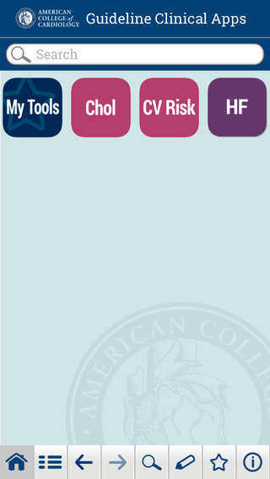
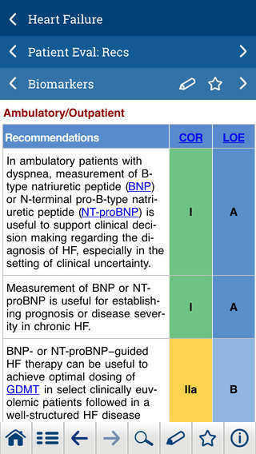
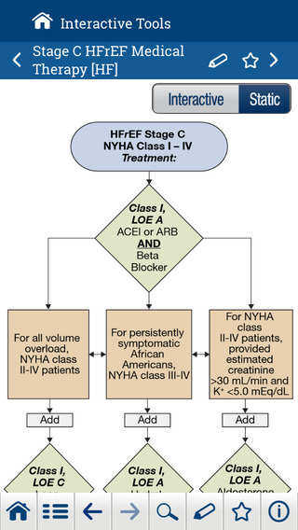

Slide 34
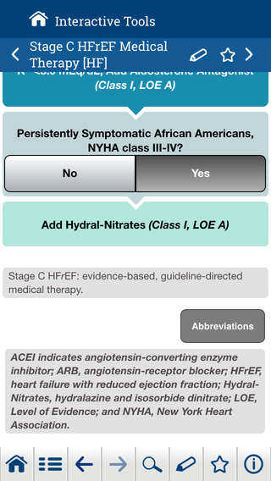
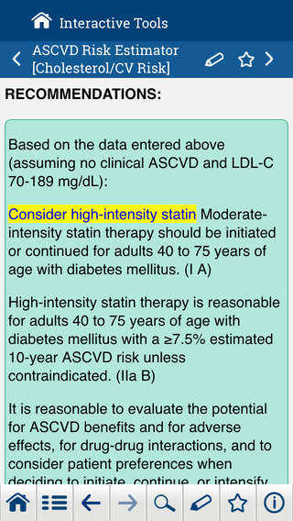

Slide 35

Questions

